Slide 1



Thank You To Our Sponsors

Slide 2
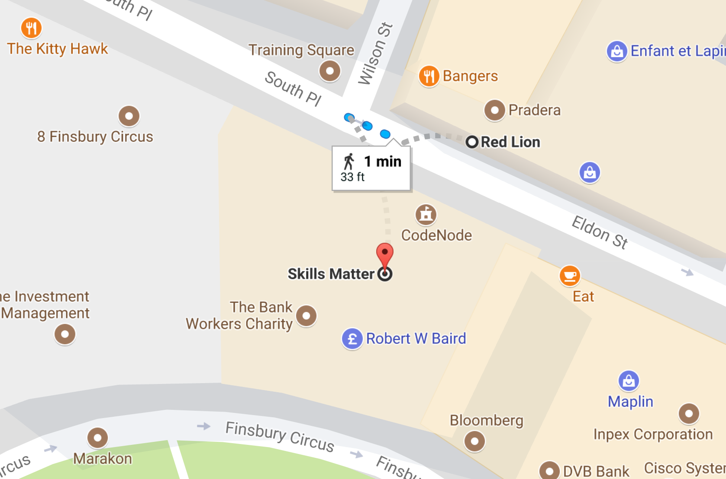
Thank You To Our Sponsors
Thank You To Our Post-Event
Drink Sponsors
Come and Join us for some drinks at the Red Lion after the event

